Slide 1
Consumer Pulse Report (CPR)
August 13,2024

Slide 2
CPR Background
Research subject population : US Gen public.
Question : “Latest news or stories pertaining to Ford”
Sample size : 9398 (Aug ‘23 to Jul ‘24)
Insights from NLP (in the deck):
Topic prediction
Level-2 granularity of topics
Sentiment Analysis
Ford vehicle model mentions
Future prospects :
Linking comments to recent news/events ( Examples : #Lightning Launch, #New F-150, #UAW strike)
Distribution of NLP insights among demographics (quant fields) like age, gender, cohorts etc.

Slide 3
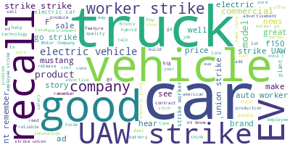
Word-cloud
Trucks, cars, EV, the UAW strike and recall find significant number of mentions.

Slide 4
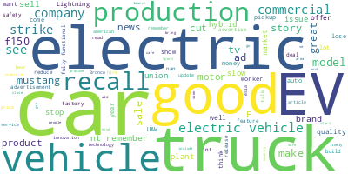
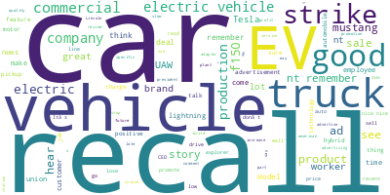
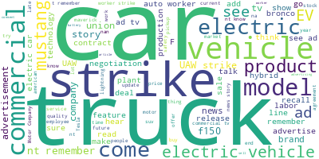
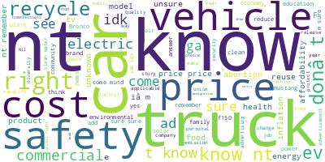
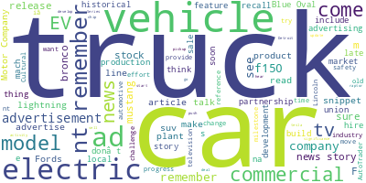
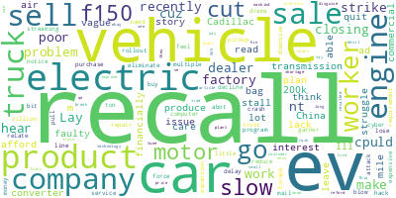
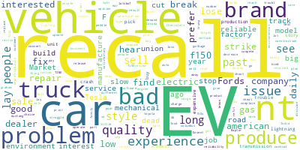
Word-cloud by Month
Jan-24
Feb-24
Mar-24
Apr-24
May-24
Jun-24
Jul-24
Recall continues to be a topic of discussion along with EV. There is also mention of Car and Truck across months

Slide 5
Topics Considered - Summary
Level 1 | Level 2
Product related | Popular products
 | Product Launches
 | Quality Issue, Service, Recalls
Electrification | General
 | Charging related
 | EV Production challenges
 | EV products
Corporate issues | General
 | UAW strike, contract renewal, lay offs
Branding | Campaigns, advertisements, billboards, deals, offers
New technology, unique features/services | General
 | Innovation and Technology
 | New features
 | Self driving cars
Organization feedback | General, Sales, Strategy, Product portfolio, Stock
Other | General feedback

Slide 6
Category summary
Accuracy of Model : 95 %
The highest number of relevant comments are about Corporate Issues, followed by Product Related Feedback

Slide 7
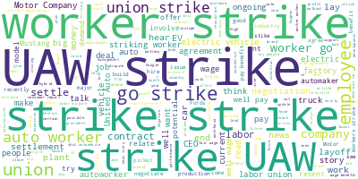
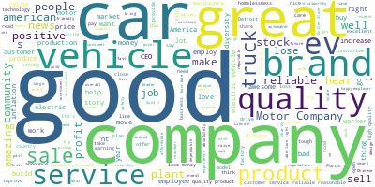
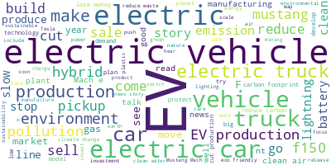
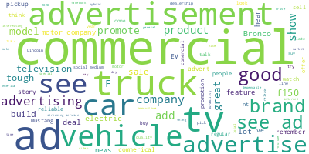
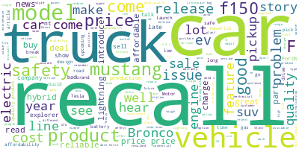
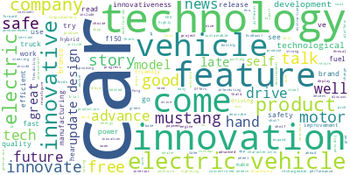
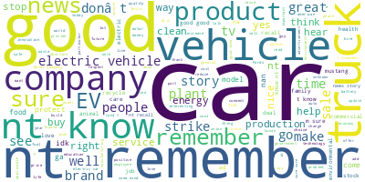
Category wordclouds
Corporate issues
Org feedback
Electrification
Branding
Product related
New technology/Unique features
Other
Corporate issues has lot of mentions of the “UAW strike”, Comments about Electrification are mostly about the F-150 trucks (Lightning), Mustang and Ford’s EV production. Product related comments majorly discuss “Recalls”
Electrification

Slide 8
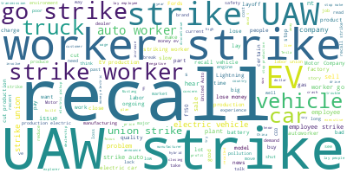
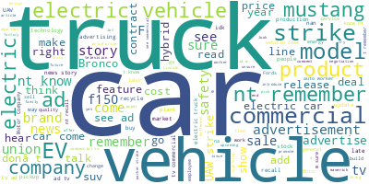
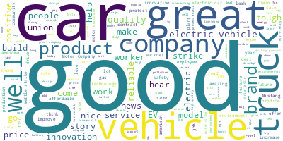
Sentiment summary
Accuracy of Model : 91%
Negative
Neutral
Positive
The recall of vehicles and strikes were major topics discussed in a negative light, whereas the positive sentiment is primarily about Ford’s great reputation, trucks and car products.

Slide 9
Sentiment for Categories
Corporate issues category takes up most of the negative sentiment comments, whereas the organization feedback has mostly positive sentiment

Slide 10
Product Mention summary
F-150 and Mustang have top 2 number of mentions.

Slide 11
Product Mention Category Distribution
F-150 has the highest number of mentions, distributed majorly among Product related, Electrification and Branding categories

Slide 12
Sentiment for Products
Most of comments with Product mentions are neutral. But there is a significant negative sentiment in comments mentioning Lightning and Explorer.

Slide 13
Branding – key topics
New Vehicle Advertisements: Many respondents mentioned seeing advertisements for new Ford vehicles, including the F-150, Bronco, Maverick, and Mustang. These ads highlighted the features, capabilities, and performance of the vehicles.
Brand Promotion: Several respondents commented on Ford's brand promotion efforts, such as emphasizing the company's heritage, durability, and American-made quality. The ads showcased Ford's commitment to innovation and customer satisfaction.
Commercials and Ads: Many respondents simply mentioned seeing commercials or advertisements for Ford without providing specific details.
Corporate issues – key topics
Strike: This topic covers news about strikes or potential strikes involving Ford workers. It includes discussions about the demands of the workers, the impact of the strike on production and sales, and the ongoing negotiations between the company and the union.
Layoffs: This topic focuses on reports about Ford conducting layoffs or potential job cuts. It includes information about the number of employees affected and the reasons behind the layoffs.
Contract Renewal or Settlement: A significant number of responses indicated that Ford Motor Company and the UAW reached an agreement or settlement to end the strike.

Slide 14
Electrification – key topics
Ford's Transition to Electric Vehicles: Ford Motor Company is shifting its focus towards electric vehicles and plans to discontinue its line of fuel vehicles in the future. The company is investing heavily in the development of electric vehicle technology and is partnering with Volkswagen Group to accelerate this transition.
New Electric Vehicle Models: Ford has introduced several new electric vehicle models, including the electric F-150, electric Mustang, and electric Maverick. The company is also expanding its lineup of hybrid vehicles and plans to increase its production of electric vehicles in the coming years.
Financial Performance or Challenges of Evs: Ford has been facing financial losses due to its investments in electric vehicles. The company is reassessing its EV strategy and considering a shift towards hybrid vehicles to improve profitability. Ford has faced challenges in the electric vehicle market, including lower than expected demand for its electric F-150 and technical issues with the Mach-E.
Environmental Impact and Sustainability: Ford is committed to becoming more eco-friendly and reducing its carbon emissions. The company's focus on electric vehicles is driven by the need to meet environmental regulations and consumer demand for sustainable transportation.
Future Plans and Strategies: Ford is continuing to develop its EV technology and plans to introduce more electric vehicles in the future. The company is also exploring the possibility of expanding its electric vehicle production capacity and investing in renewable energy sources.

Slide 15
New technology or unique features – key topics
New Features: Ford vehicles are being equipped with cutting-edge features that provide convenience, safety, and entertainment. Ford is introducing various new features in its vehicles, including hands-free driving, advanced safety systems, and improved performance.
Innovation and Technology: The brand is showcasing its commitment to innovation and staying ahead of the curve in the automotive industry. The brand is updating its existing models with innovative technologies and enhanced capabilities.
Product related – key topics
New Vehicle Models: Ford has released a number of new vehicles in recent years, including the Bronco Sport, F-150, F-250 etc
Safety and Quality: Ford Motor Company has issued a recall for several of its vehicles due to safety concerns. Ford has issued several recalls to address these issues and is working to improve the quality of its vehicles.
General Product Related: Any comments related to product other than product launch, new products, quality, saftey and recall.

Slide 16
Organization feedback – key topics
Brand Reputation: Many comments highlighted the positive reputation of Ford Motor Company, with people praising its quality, reliability, and durability. Several comments mentioned that Ford is an American company that cares for the people and employs more Americans than any other automaker.
Products and Services: People expressed satisfaction with Ford's products and services, including their vehicles, customer service, and affordability.
Innovation and Technology: Comments highlighted Ford's commitment to innovation and technology, such as their development of electric vehicles and focus on fuel efficiency.
Job Creation or Employee Welfare: Many people mentioned that Ford Motor Company provides jobs for Americans and is expanding its workforce.
Community Involvement: Some comments mentioned Ford's positive impact on the community, such as their philanthropic efforts and support for charities.
Challenges: A few comments mentioned challenges faced by Ford, such as losses on electric vehicles and plant closures.

Slide 17
CPR January ’24 Result
Accuracy of Model Sub Category Level: 90%
Accuracy of Model Category Level: 93%
Sub Category | Category | Count
Electric Vehicle Production and Challenges | Electrification | 48
New Product EV Launches |  | 27
New Product Launches | Product related | 59
Recalls and Safety Issues |  | 30
General Product related |  | 53
Technological Advancements | New technology or unique features | 10
Marketing and Advertising | Branding | 45
Union Agreements and Labor Issues | Corporate issues | 32
Financial Performance | Organization feedback | 11
Plant Investments and Expansions or Closures |  | 11
General Brand Perception and Customer Satisfaction |  | 55
Other | Other | 83
The highest number of comments are about New Product Launches.

Slide 18
CPR February ‘24 Result
Accuracy of Model Sub Category Level: 97%
Accuracy of Model Category Level: 97%
Sub Category | Category | Count
Electric Vehicle Production and Challenges | Electrification | 16
New EV Launches and Updates |  | 29
New Product Launches | Product related | 37
Recalls and Safety Issues |  | 43
General Product related |  | 105
Technological Advancements | New technology or unique features | 7
Marketing and Advertising | Branding | 48
Labor Issues | Corporate issues | 34
Financial Performance | Organization feedback | 9
Production and Manufacturing |  | 12
General Brand Perception and Customer Satisfaction |  | 18
Other | Other | 91
Total |  | 449
The highest volume of comments are General Product related feedback.

Slide 19
CPR March ‘24 Result
Accuracy of Model Sub Category Level: 98%
Accuracy of Model Category Level: 98%
Sub Category | Category | Count
Electric Vehicle Production and Manufacturing | Electrification | 14
EV Launches and Updates |  | 46
Environmental Sustainability and Electrification |  | 4
New Product Launches | Product related | 70
Recalls and Safety Issues |  | 24
General Product related |  | 28
Technological Advancements | New technology or unique features | 6
Marketing and Advertising | Branding | 59
Labor Issues | Corporate issues | 30
Financial Performance | Organization feedback | 10
Executive Leadership and Company Strategy |  | 4
General Brand Perception and Customer Satisfaction |  | 55
Community Involvement and Social Responsibility |  | 2
Other | Other | 114
Total |  | 466
The highest volume of comments are about New Product Launches.

Slide 20
CPR April ‘24 Result
Accuracy of Model Sub Category Level: 94%
Accuracy of Model Category Level: 94%
Sub Category | Category | Count
Electric Vehicle Production and Manufacturing | Electrification | 9
EV Launches and Updates |  | 42
Environmental Sustainability and Electrification |  | 180
New Product Launches | Product related | 89
Recalls, Safety and Quality |  | 120
General Product related |  | 121
Affordability and Pricing |  | 143
Technological Advancements | New technology or unique features | 5
Marketing and Advertising | Branding | 65
Labor Issues and Workforce Management | Corporate issues | 61
Financial Performance and Business Outlook | Organization feedback | 39
Executive Leadership and Company Strategy |  | 3
General Brand Perception and Customer Satisfaction |  | 74
Community Involvement and Social Responsibility |  | 62
Other | Other | 1871
Total |  | 2884
The highest volume of comments are about Environmental Sustainability and Electrification. A spike is observed in the volume of comments in this month.

Slide 21
CPR May ‘24 Result
Accuracy of Model Sub Category Level: 96 %
Accuracy of Model Category Level: 96 %
Sub Category | Category | Count
Electric Vehicle Production and Manufacturing Updates | Electrification | 8
New Product EV Launches |  | 46
Environmental Sustainability and Electrification |  | 4
New Product Launches | Product related | 77
Recalls and Safety Issues |  | 44
General Product related |  | 38
Technological Advancements | New technology or unique features | 11
Marketing and Advertising | Branding | 60
Expansion and Investments |  | 6
Labor Issues | Corporate issues | 29
Financial Performance | Organization feedback | 24
Executive Leadership and Company Strategy |  | 2
General Brand Perception and Customer Satisfaction |  | 47
Other | Other | 143
Total |  | 539
The highest volume of comments are about New Product Launches.

Slide 22
CPR June ‘24 Result
Accuracy of Model Sub Category Level: 98 %
Accuracy of Model Category Level: 98 %
Sub Category | Category | Count
Electric Vehicles | Electrification | 24
Product Line Improvements | Product related | 8
Recalls and Safety |  | 22
General Product related |  | 38
Technological Advancements | New technology or unique features | 34
Marketing and Advertising | Branding | 64
Brand Reputation and Perception |  | 26
Labor Relations and Workforce | Corporate issues | 13
Competitors and Industry trends |  | 178
Leadership and Management |  | 1
Financial Performance and Sales | Organization feedback | 2
Environmental Initiatives |  | 2
Company Growth and Expansion |  | 7
Community Involvement and Philanthropy |  | 2
Other | Other | 116
Total |  | 537
The highest volume of comments are about Competitors and Industry Trends.

Slide 23
CPR July ‘24 Result
Accuracy of Model Sub Category Level: 97 %
Accuracy of Model Category Level: 97 %
Sub Category | Category | Count
Brand Perception | Branding | 14
Labor Relations | Corporate issues | 15
Sustainability |  | 2
Electric Vehicles | Electrification | 54
Innovation | New technology, unique features/services | 9
Community Involvement | Organization feedback | 4
Financial Performance |  | 16
Other | Other | 268
New Product Launches | Product related | 97
Quality Issues |  | 39
Recalls |  | 24
Total |  | 542
The highest volume of comments are about New Product Launches followed by EV.

